Slide 1
12
Prediction

Slide 2
Regression
Regression – predict the relationship between variables and therefore be able to predict people’s scores

Slide 3
Prediction -1
Psychologists construct mathematical rules to predict people's scores on one variable from knowledge of their score on another variable (predicting college grades from SAT scores)
Prediction is also called “regression”

Slide 4
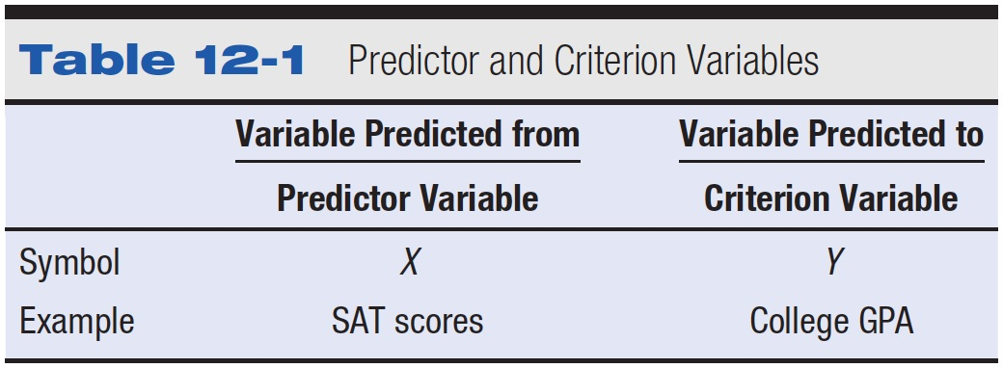
Table 12-1 Predictor and Criterion Variables

Slide 5
Predictor and Criterion Variables
By convention
  Predictor variables are designated by X
  Criterion variables are designated by Y

Slide 6
Predictor and Criterion Variables
Predictor variable (X) – variable that is used to predict scores of individuals on another variable
Criterion variable (Y) – a variable that is predicted
Copyright © 2009 Pearson Education, Inc. Upper Saddle River, NJ 07458. All rights reserved.

Slide 7

The Linear Prediction Rule -1
Using raw scores, the prediction model is
  Predicted raw score (on the criterion variable) = regression constant plus the product of the raw score regression coefficient times the raw score on the predictor variable
  Formula

Slide 8
The Linear Prediction Rule -2
Regression constant (a)
  Predicted raw score on criterion variable when raw score on predictor variable is 0
Regression coefficient (b)
  How much the predicted criterion variable increases for every increase of 1 on the predictor variable

Slide 9
The Linear Prediction Rule -3
Figure the regression constant (a)
Figure the raw-score regression coefficient (b)
Find predicted raw score on the criterion variable
Again, the formula is

Slide 10
The Regression Line
Indicates the relation between predictor variable and predicted values of the criterion variable
Slope of the regression line
  Equals b, the raw-score regression coefficient
Intercept of the regression line
  Equals a, the regression constant

Slide 11
Drawing the Regression Line -1
Draw and label the axes for a scatter diagram
Figure predicted value on criterion variable for a low value on predictor variable – mark the point on graph
Repeat step 2. with a high value on predictor variable
Draw a line passing through the two marks

Slide 12
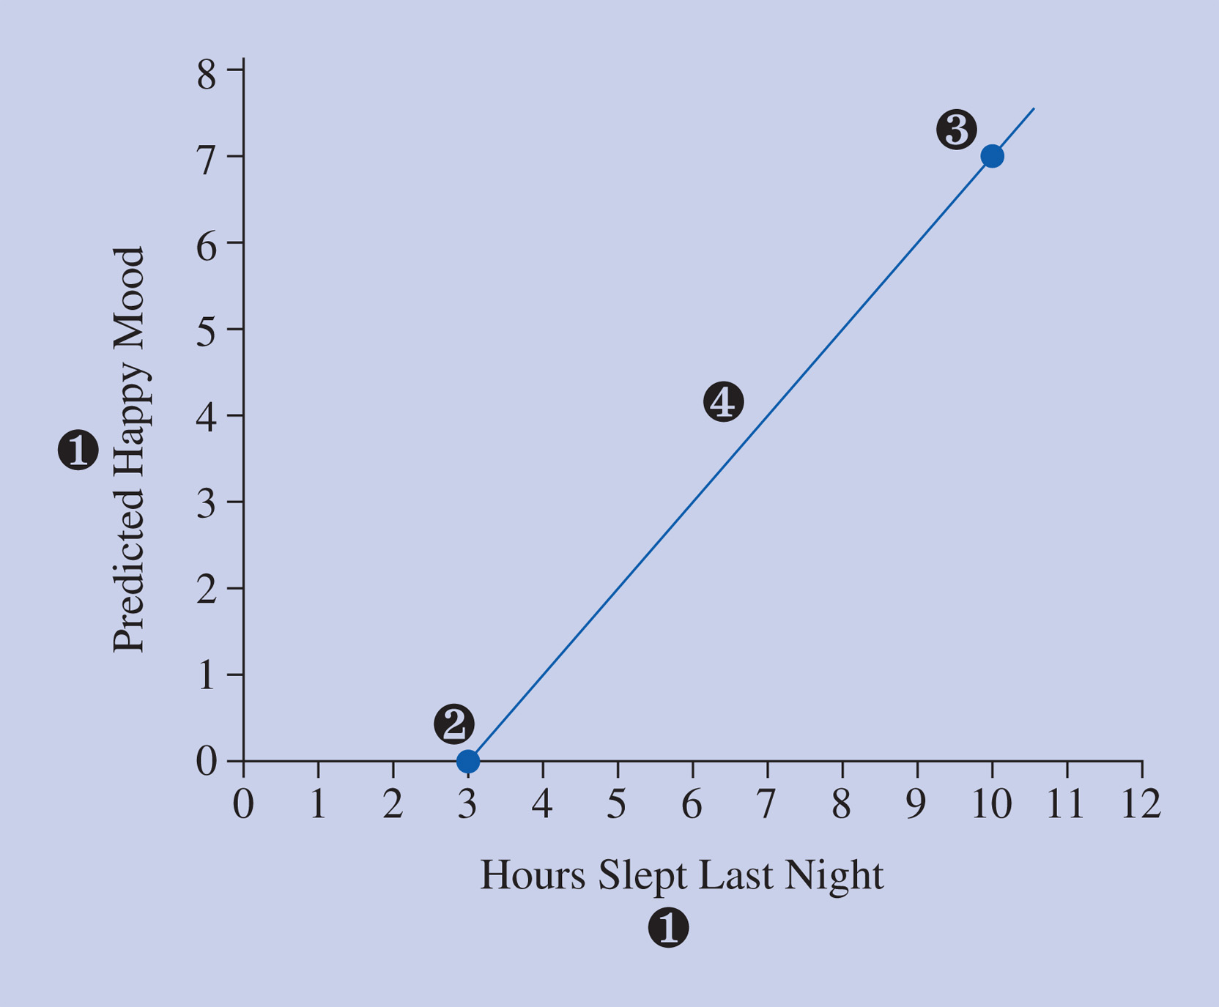
Figure 12-4 Steps in drawing a regression line for the hours of sleep and happy mood example. (1) Draw and label the axes, (2) mark a point for a low value of the predictor variable and its predicted value on the criterion variable, (3) mark a point for a high value of the predictor variable and its predicted value on the criterion variable, and (4) draw the regression line.

Slide 13
Least Squared Error Principle
Used to determine the one best prediction rule
Error
  Actual score minus the predicted score
The best prediction rule has the smallest sum of squared errors

Slide 14

Formulas for the Least Squared Error Principle
To find the regression coefficient
To find the regression constant

Slide 15
Issues in Prediction
Standardized regression coefficient – beta – regression coefficient in standard deviation units
  Use for standardized relationships, so you can compare across studies
  Beta = r when only one predictor

Slide 16

Standardized Regression Coefficient
Regression coefficient expressed in standard deviation units
With one predictor variable, the standardized regression coefficient is equal to the correlation coefficient

Slide 17
Hypothesis Testing
Null is that beta = 0, x does not predict y
Res is that beta does not equal 0, x does predict y

Slide 18
Hypothesis Testing
Comparison distribution
  Beta
  Df (N-2)

Slide 19
Hypothesis Testing
Step 3
  Cut off score is a t-value with df from step 2
Step 4
  Use the r formula from the previous chapter
  t = r / √(1-r²)/(N-2)

Slide 20
Hypothesis Testing
Step 5
  Is step 4 < > step 3?
    Depends on the test type (one versus two tailed).

Slide 21

Multiple Regression
Multiple regression prediction models
  Each predictor variable has its own regression coefficient
  Multiple regression formula with three predictor variables:

Slide 22
Multiple Correlation
R = correlation between the criterion variable and all the predictor variables taken together

Slide 23
Assumptions of Prediction
The significance test for prediction assumes:
  An equal distribution of each variable at each point of the other variable
  A linear relationship between variables
  That the cases are independent
  That the error scores are normally distributed

Slide 24
Limitations of Regression
Regression inaccurate if
  Correlation is curvilinear
  Restriction in range is present
  Unreliable measures are used

Slide 25
Controversies and Limitations
Controversy about how to judge the relative importance of each predictor variable in predicting the dependent variable
Consider both the r’s and the β’s

Slide 26
Prediction in Research Articles
Bivariate prediction models rarely reported
Multiple regression results commonly reported

Slide 27
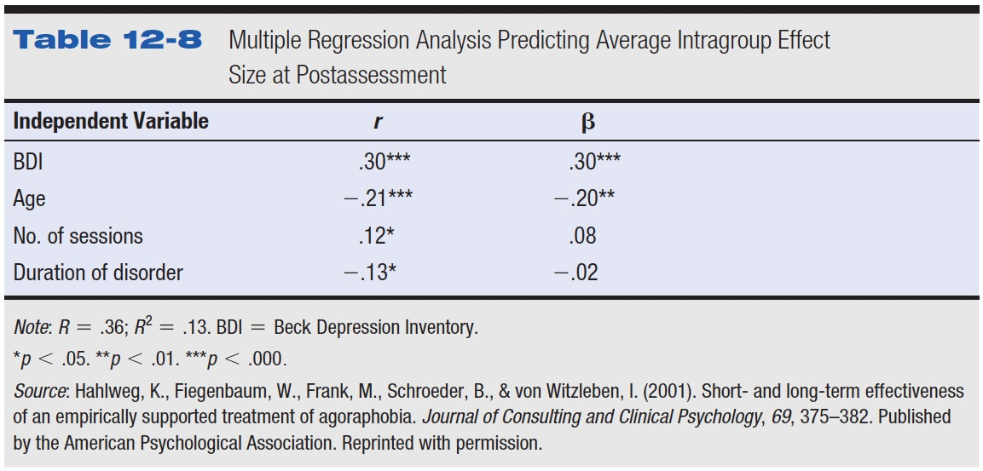
Table 12-8 Multiple Regression Analysis Predicting Average Intragroup Effect Size at Postassessment

Slide 28
Proportionate Reduction in Error -1
Error
  Actual score minus the predicted score
Proportionate reduction in error
  Squared error using prediction model = SS_{Error}
  Total squared error when predicting from the mean = SS_{Total}

Slide 29

Proportionate Reduction in Error -2
Formula for proportionate reduction in error:
Proportionate reduction in error = r²
Proportion of variance accounted for

Slide 30
A health psychologist conducts a study on whether the relation of proportion of fat in a person's diet predicts the proportion of time the person uses a seat belt with the idea is that those who practice one kind of health-related behavior may be more likely to practice another kind. The results for three participants follow. Use p < .05.
X Y
  25 30
  15 40
  50 10
  30 25
a. Figure the linear prediction rule.
b. Predict the seat belt usage of a person who has 40% (.40) fat in their diet.
c. Make a graph with the regression line.
d. Figure the standardized regression coefficient starting with the regression coefficient you figured in a. above.

Slide 31
Is there a relationship between GPA and number of hours TV watched? Write out the hypothesis testing steps to see if TV hours watched (X) predicts GPA (Y), using p < .05.
Participant GPA TV in hours per week
  #1 3.1 14
  #2 2.4 10
  #3 2.0 20
  #4 3.8 7
  #5 2.2 25
  #6 3.4 9
  #7 2.9 15
  #8 3.2 13
  #9 3.7 4
  #10 3.5 21

